Slide 1

Toward Equitable AI: Probing Cultural Bias in CLIP
A Latent-Space Evaluation of Vision–Language Models
EECE 570
Annie Wang
Notes:
My name is Annie Wang, This is my video presentation about my EECE 570 course project, which is motivated by the increasing deployment of VLMs like CLIP and the concern over their cultural biases.

Slide 2
Motivation & Research question
Vision–language models like CLIP learn from large-scale, Western-centric web data
Cultural bias in outputs is known, but:
→ Is bias encoded in the model’s latent space?
Our focus: latent bias in CLIP’s image and text embeddings
Two main research questions:
Are Western image clusters tighter than others?
Do captions align more with Western images?
Notes:
Vision–language models like CLIP enable tasks such as retrieval, and visual QA by learning a joint space of images and text. However, these models are trained on web-scale data dominated by English and Western content. As a result, CLIP may performs well on culturally familiar inputs fails on non-Western images
Most prior studies have focused on biased outputs. We want to know: does that bias come from the latent embedding space itself?
To investigate, we propose a two-part probing framework. We ask: (1) do Western images form denser clusters? and (2) do captions align more with Western images than others? These questions guide our analysis.

Slide 3
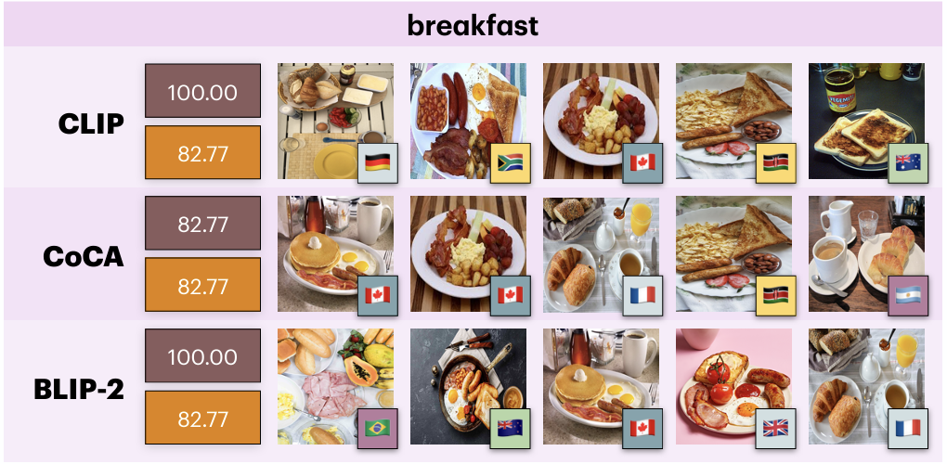


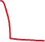

Dataset
GLOBALRG–Retrieval (Hugging Face)
3,000 image–text pairs, 20 universal concepts, 50 countries
Notes:
We use the GLOBALRG-Retrieval dataset, which provides image–text pairs curated to reflect diverse cultural contexts. It includes 3,000 examples across 50 countries and 20 universal concepts like marriage, breakfast, and dance

Slide 4
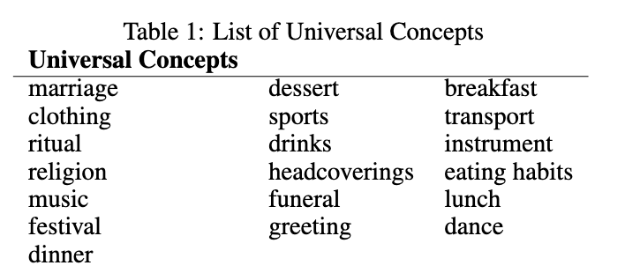
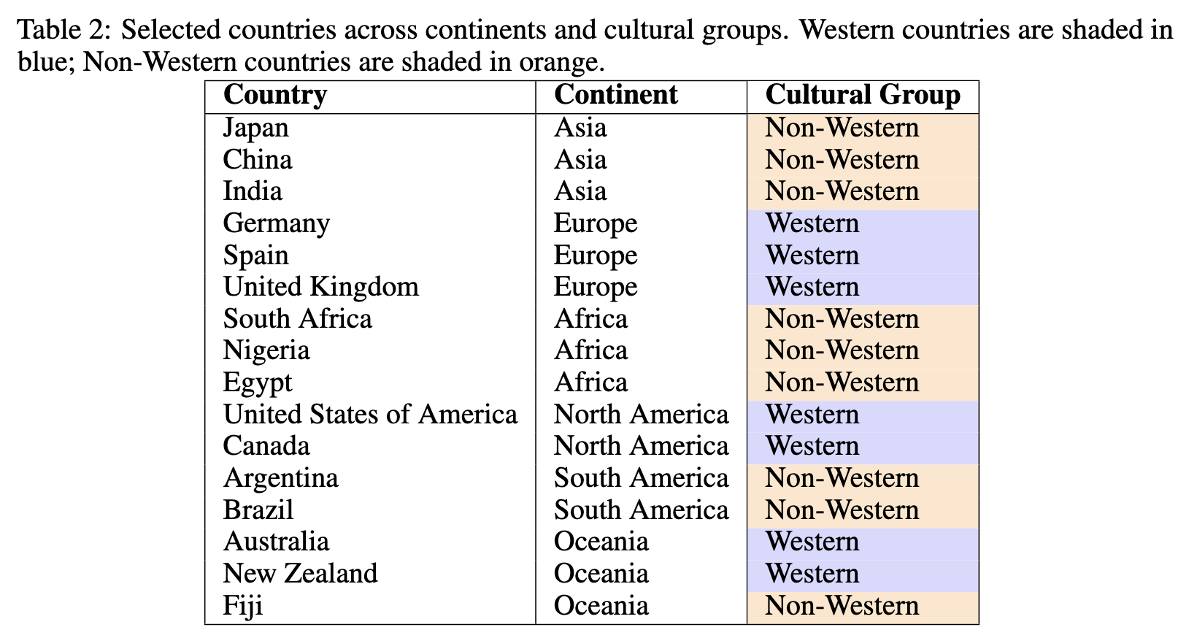
Dataset
We selected:
All universal concepts (except `farming` due to errors)
16 countries across 6 continents
Western vs. Non-Western split based on Inglehart–Welzel cultural map 7 Western & 9 Non-Western
912 image-text pair.
Notes:
We selected 16 countries across all major continents to ensure broad cultural and regional coverage. Based on the Inglehart–Welzel cultural framework, we classify 7 of those as Western (e.g., US, UK, Germany) and 9 as Non-Western (e.g., India, Egypt, Nigeria). Each country contributes 3 unique images per concept, giving us 912 total examples.
We also manually verified 10% of the dataset.

Slide 5
Methodology – System overview
Model: CLIP ViT-B/32
Embedding extraction:
Images processed using CLIPProcessor
Captions: “A photo of a {universal} ”.
512D embeddings stored for analysis in JSONL format
Notes:
We used CLIP’s ViT-B/32 model via Hugging Face. The images were standardized using CLIPProcessor.. For text, in the original dataset the text accompanied with each image is just a single term of the universal concept, we converted each universal into a caption prompt like “A photo of a wedding” to match CLIP’s pretraining style. Both image and text embeddings are 512-dimensional and stored for downstream analysis.

Slide 6
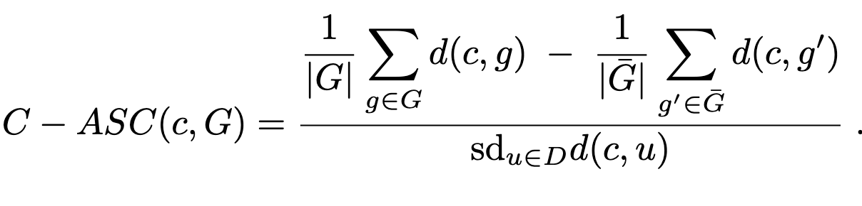
Methodology – Two Probing Tasks
Image–Image Similarity
Compare cosine similarity: WW vs. WN
Welch’s t-test to assess statistical significance
Heatmap visualizations per concept
Text–Image Alignment
Caption–Association Score (C–ASC):
UMAP visualization + global alignment map
Notes:
To examine how cultural bias might be encoded in CLIP, we use two main tasks.
The first is image–image similarity. For each concept—we look at how visually similar the images are. We compare how close Western images are to each other, versus how close they are to Non-Western ones.
The second task is text–image alignment. Here, we ask: when CLIP sees a caption like “a photo of a breakfast,” does it associate it more with Western or Non-Western images? We use a metric called C–ASC to capture this. It’s like an effect size: positive means stronger alignment with Western images, negative means Non-Western. Values around 0.2 are small, 0.5 is medium, and 0.8 or more is strong, for details please refer to the paper.
We also visualize this in two ways: one is a 2D UMAP projection to show how image and caption embeddings cluster in space. The other is a global map that ranks countries by how well their images align with the captions.

Slide 7
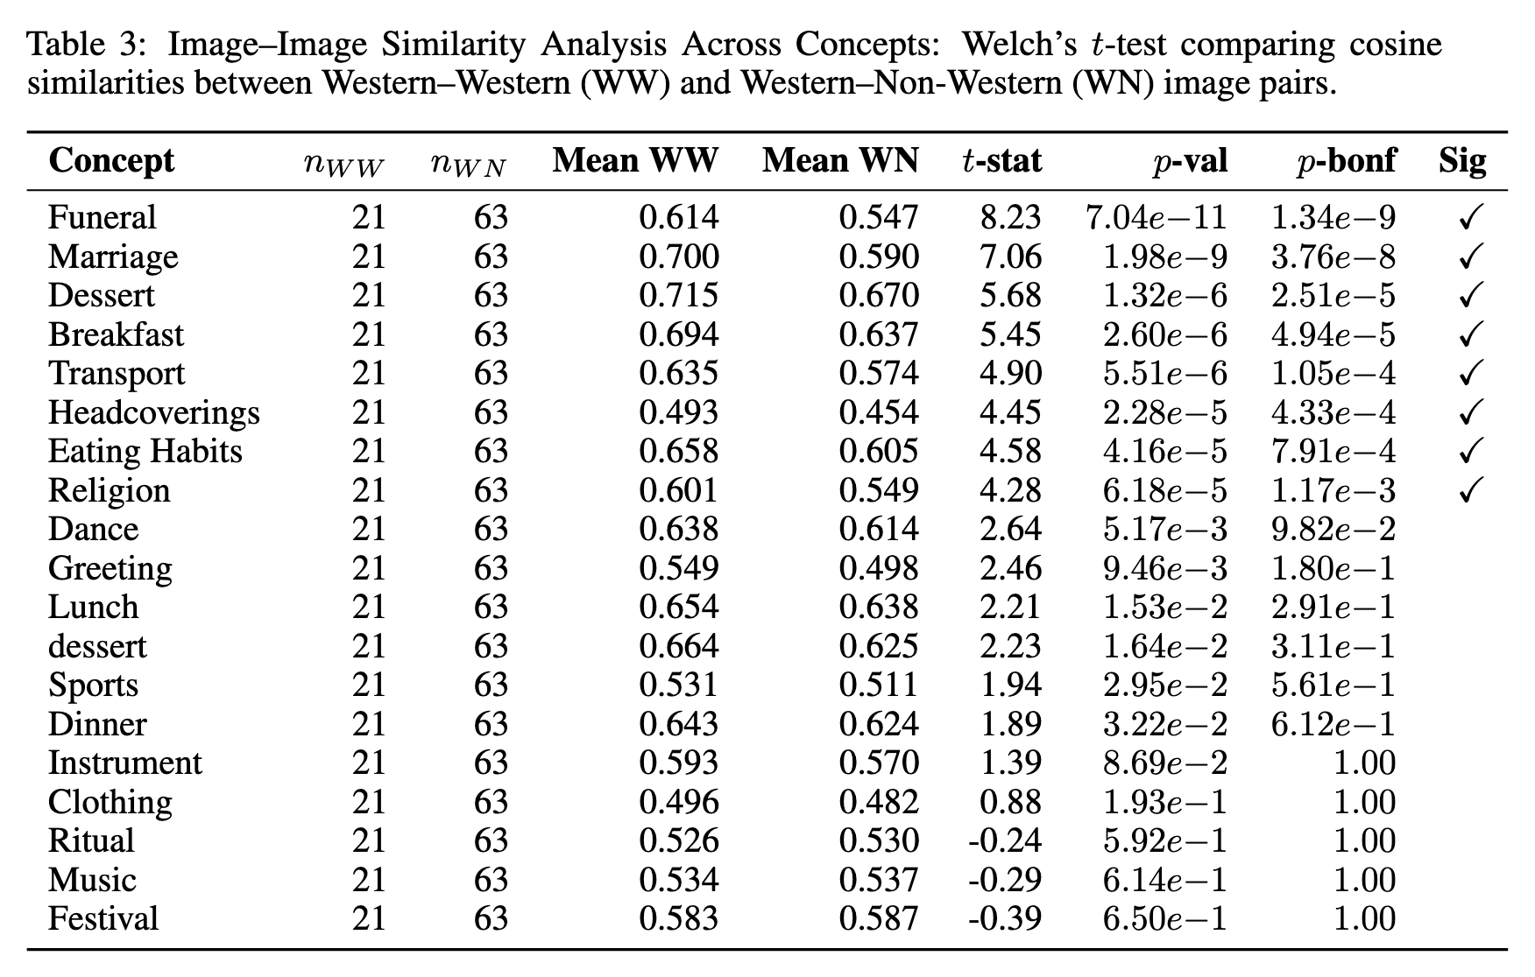
Results – Image–Image Similarity
Are Western images more closely clustered?
8 out of 19 concepts show statistically significant clustering of Western images
Notes:
To answer our first research question—whether CLIP embeds Western images more tightly—we compared similarity scores between image pairs. Specifically, we looked at Western–Western vs. Western–Non-Western pairs for each concept. The results show a clear pattern: in 8 out of 19 concepts, Western images are significantly more similar to each other. This means CLIP clusters them more tightly in the latent space.

Slide 8

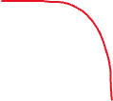
Results – Image–Image Similarity
Are Western images more closely clustered?
8 out of 19 concepts show statistically significant clustering of Western images
Notable examples: marriage, funeral, dessert, breakfast
Notes:
We see this most clearly in culturally distinct concepts like funeral, marriage, and dessert. Let’s look at the visualization.

Slide 9
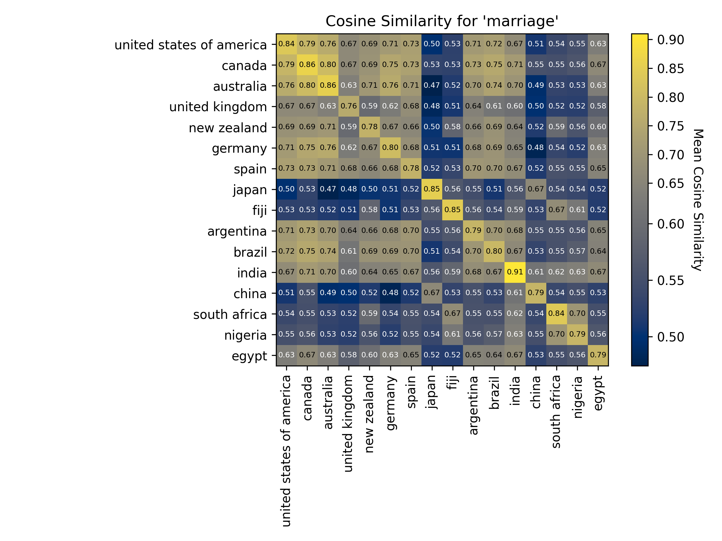

Heatmaps reveal sharper boundaries for Western vs. Non-Western regions
Western countries are bright yellow—indicating high similarity—while non-Western pairs are darker. These findings suggest CLIP encodes cultural proximity in its visual space, which may affect how the model retrieves or ranks visual content across cultures.
Notes:
The heatmaps help visualize this clustering.
For example, in the “marriage” heatmap, Western countries are bright yellow—indicating high similarity—while non-Western pairs are darker. These findings suggest CLIP encodes cultural proximity in its visual space, which may affect how the model retrieves or ranks visual content across cultures.

Slide 10




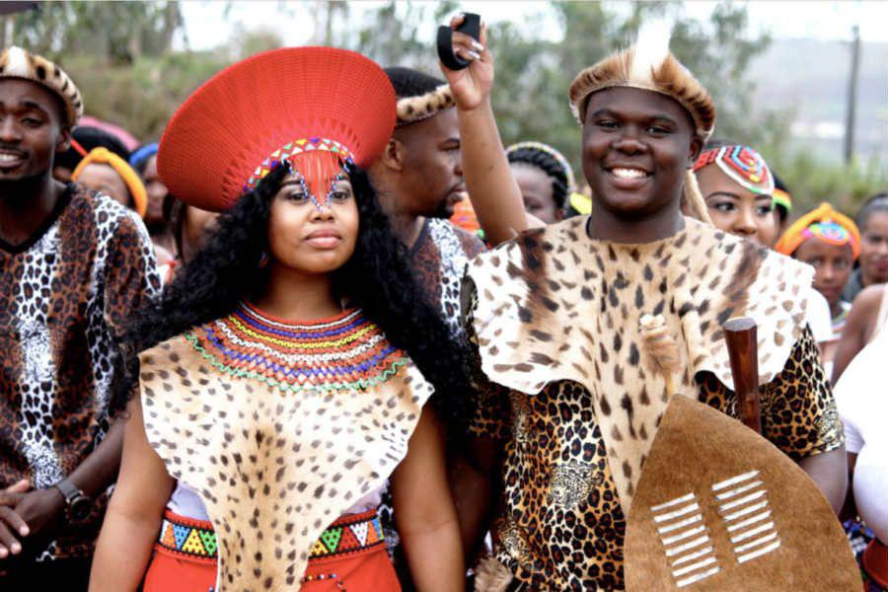
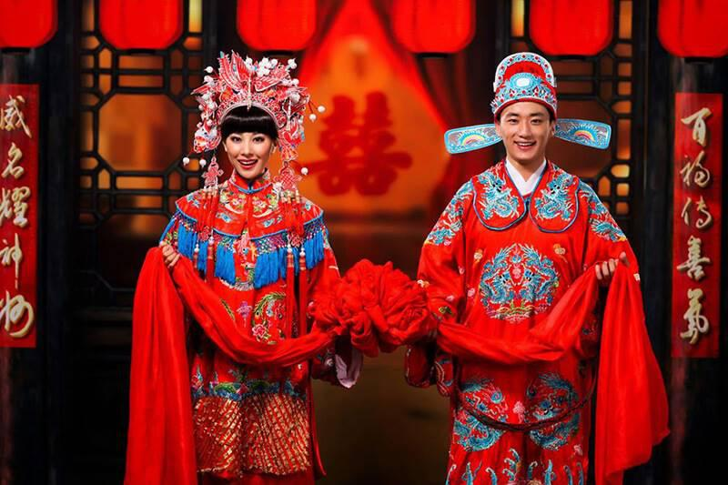
🇫🇯
🇨🇦
🇯🇵
🇦🇷
🇿🇦
🇨🇳
Notes:
Here are some example imags for marriage we sample from the dataset for various cultures. We can clearly see that those images reveal distinctive traditions and clothings of this universal human activity from around the world.

Slide 11
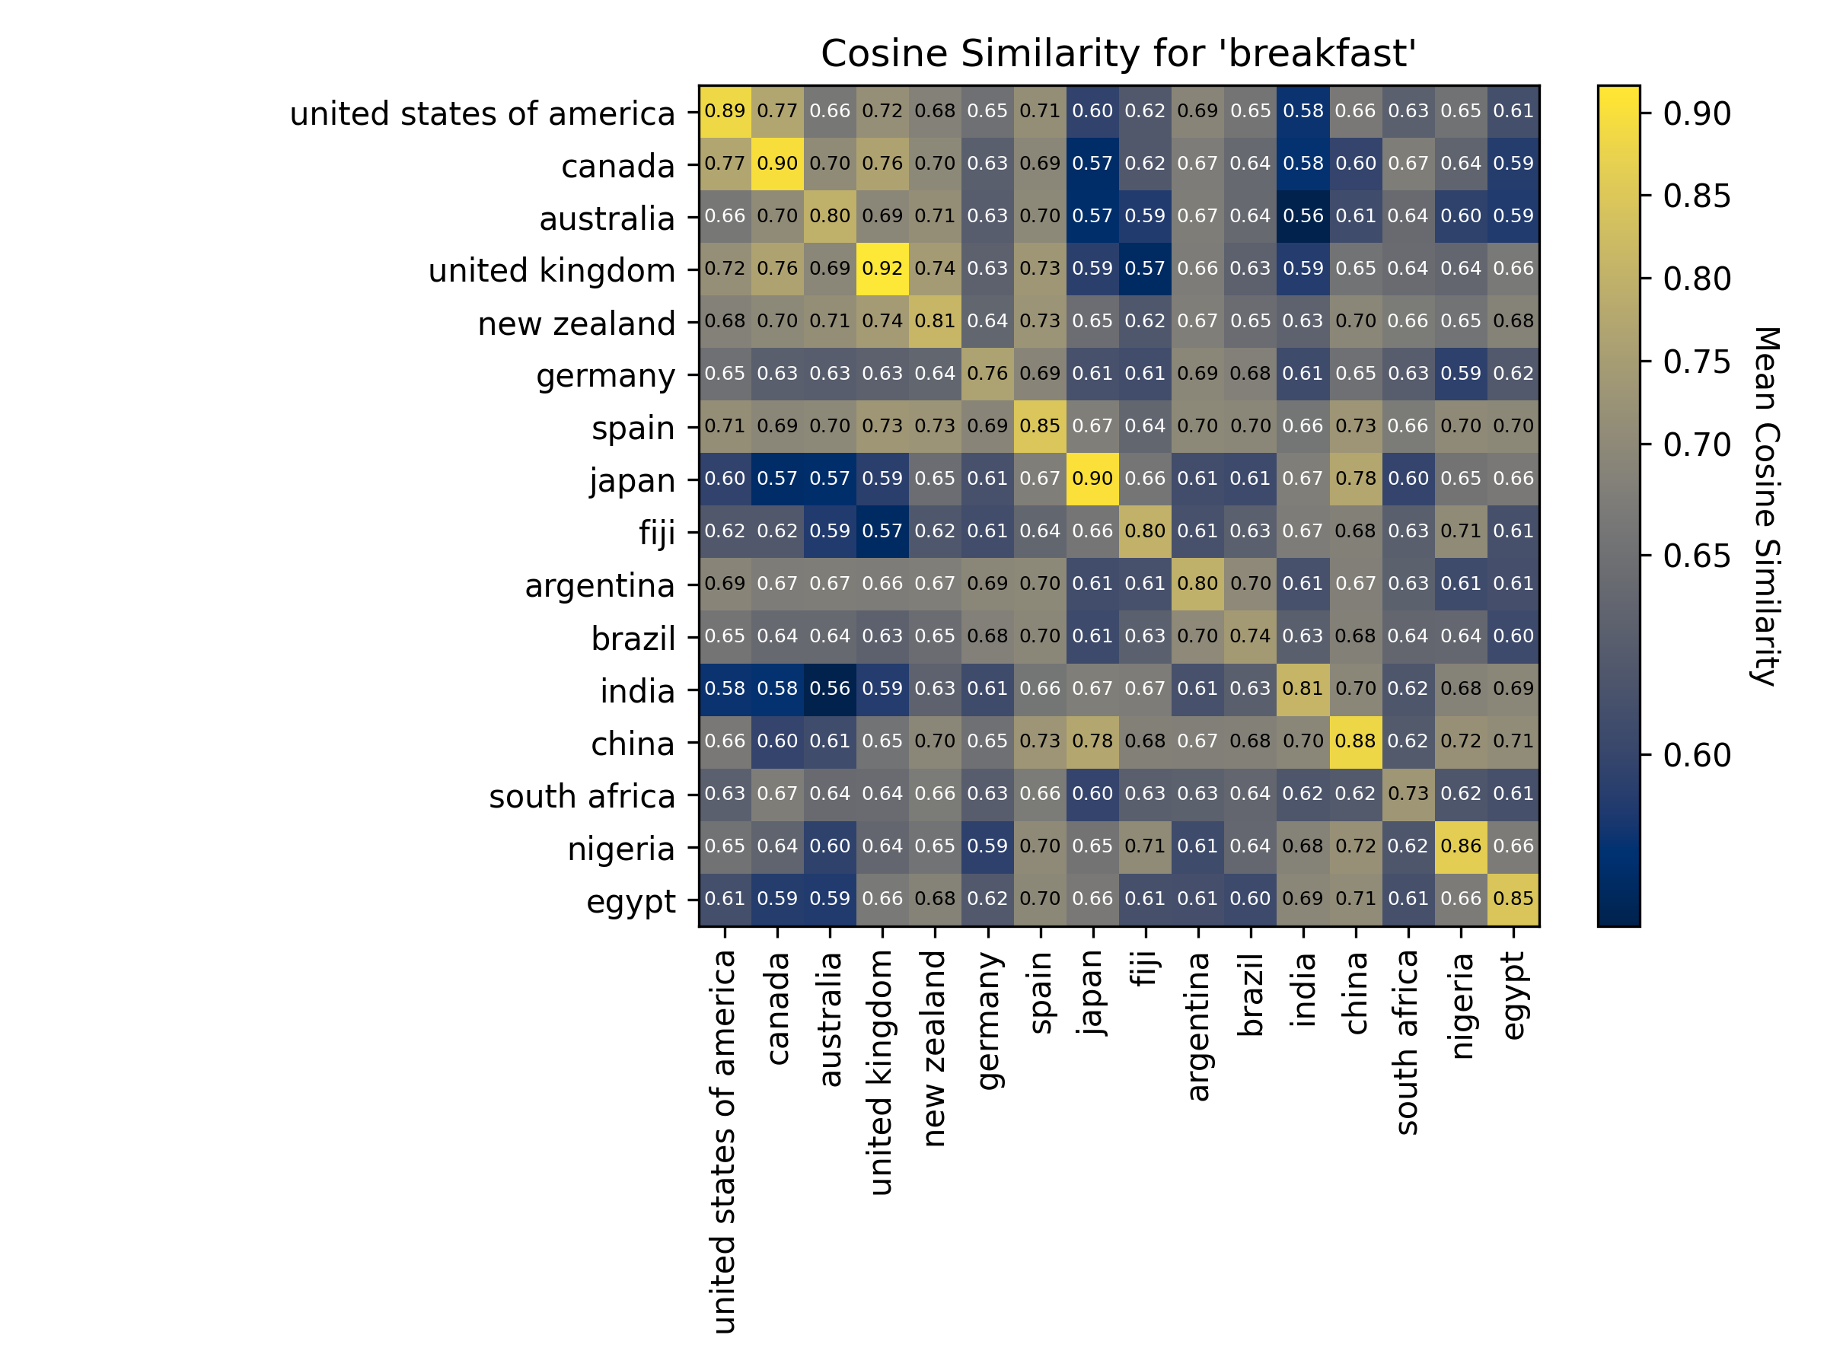
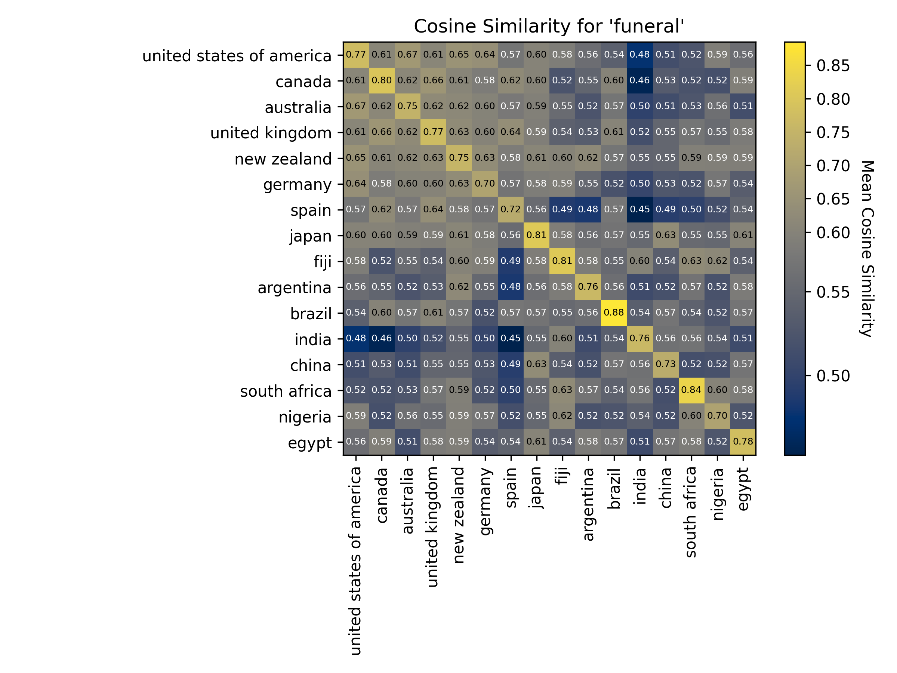


Notes:
More concepts reveal the same pattern, where image embeddings of western cultural image have higher cosine similarity as the non-western culture images. Japan in the funeral universal is slightly more similar than the other non-western cultures.

Slide 12
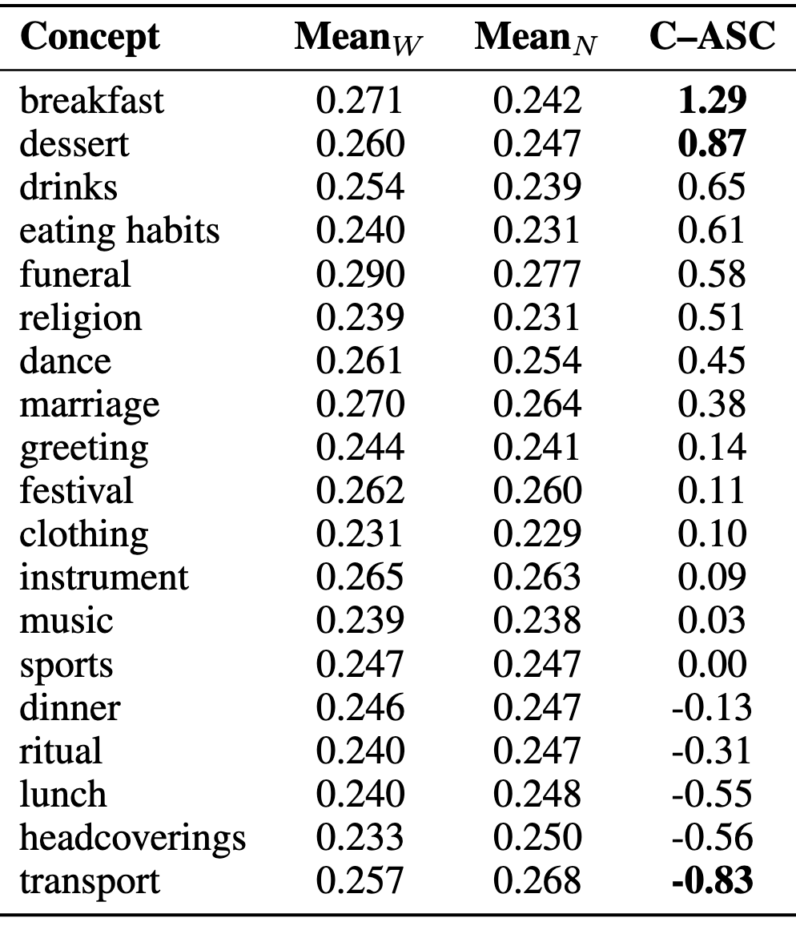

Results – Text–Image Alignment
Do captions align more with Western imagery?
Caption–Association Score (C–ASC):
Strong Western alignment: breakfast, dessert
Non-Western alignment: transport, headcoverings, lunch
Notes:
To address our second question—whether CLIP’s caption embeddings align more with certain cultures—we used the C–ASC score. This measures whether a text like “a photo of a breakfast” is closer to Western images or non-Western ones in embedding space.
We found that captions for concepts like breakfast and dessert align much more closely with Western imagery, while captions for transport and headcoverings align more with non-Western visuals. This shows the model doesn’t just “prefer” one culture globally—it depends on the topic.
Now moving on to visualizing those biases

Slide 13
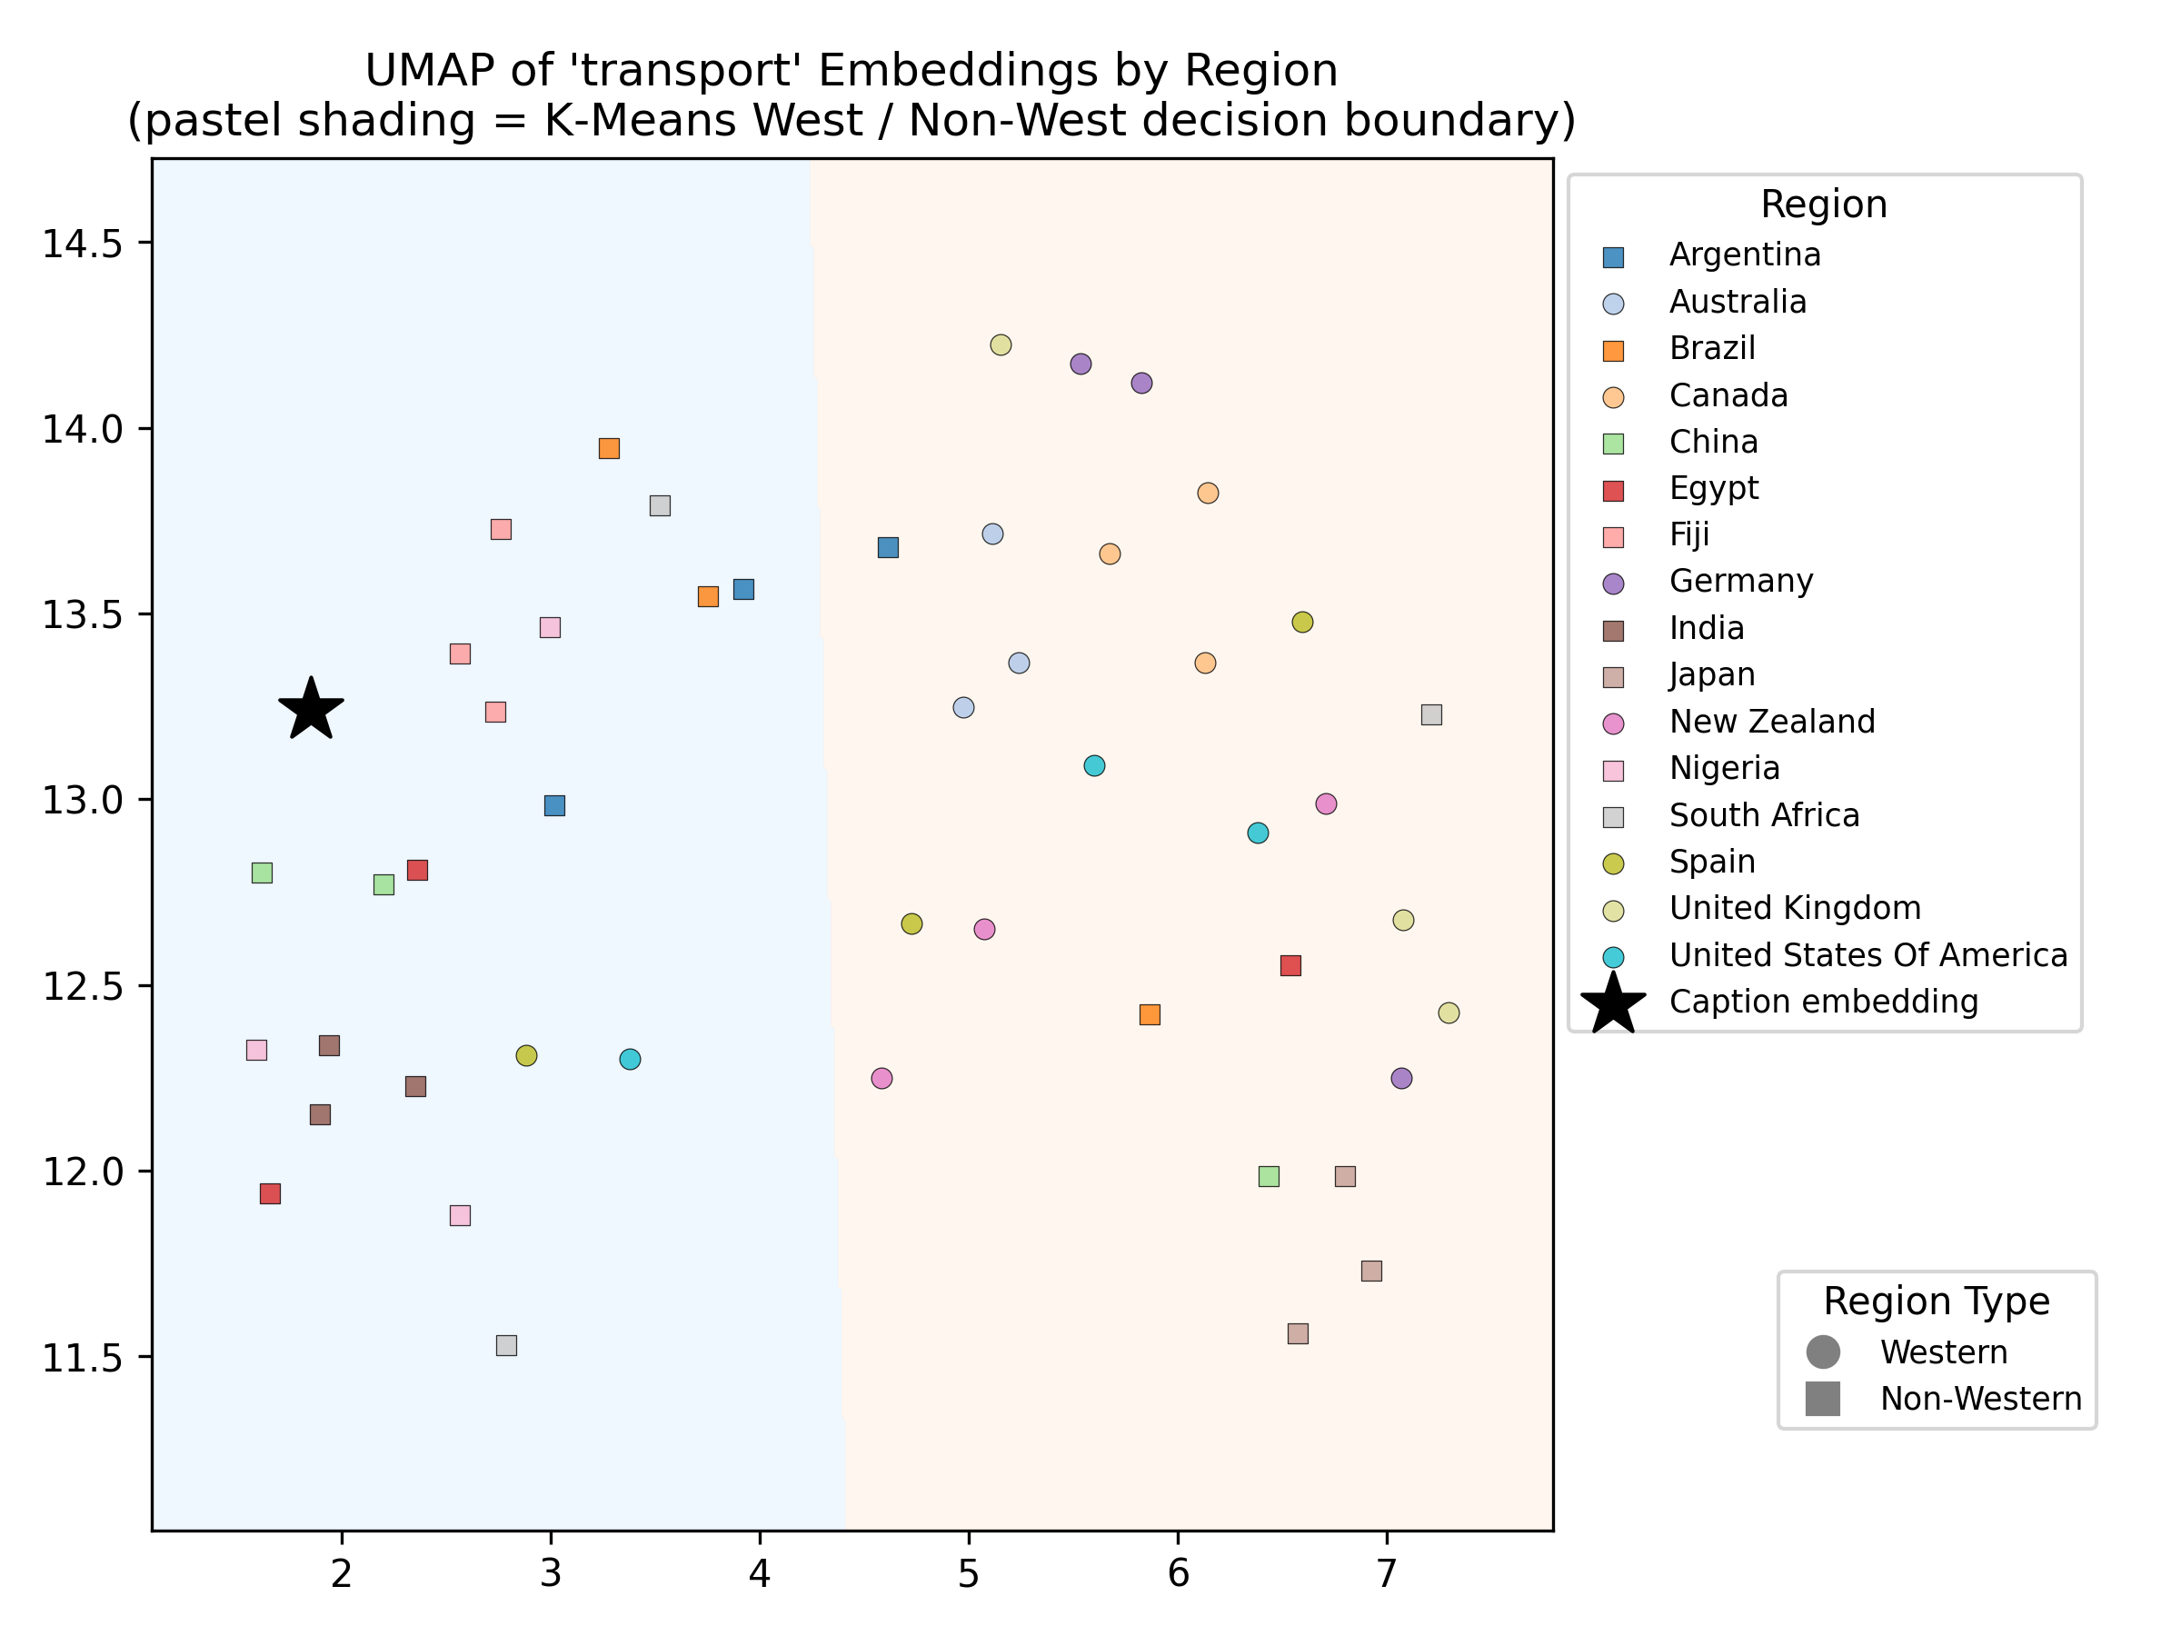
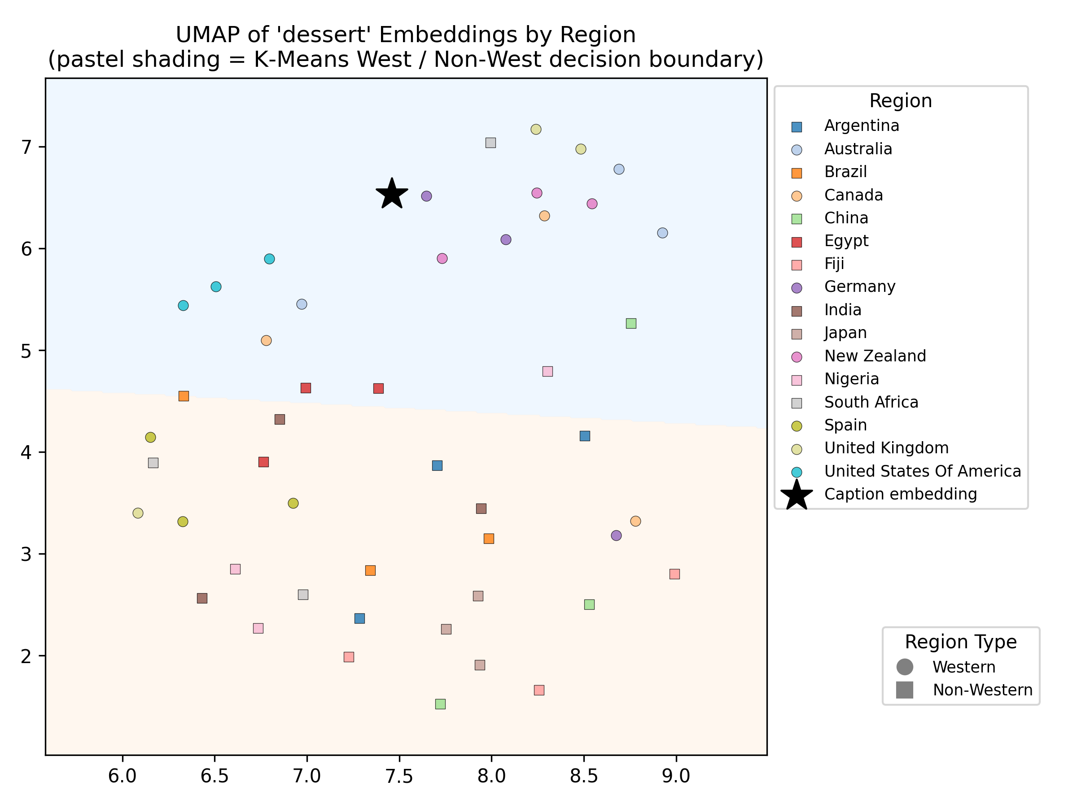
UMAP embedding plots
“A photo of a dessert”
“A photo of a transport”
Transport
C-ASC = -0.83
Dessert
C-ASC = 0.87
Notes:
Here, we visualize CLIP’s latent space by projecting image and caption embeddings into 2D using UMAP. Each dot is an image embedding, with different shapes representing Western vs. Non-Western regions. The black star marks the caption embedding—for example, “a photo of a dessert.”
These plots help us see clustering patterns. In dessert, the caption is embedded closely within Western images, reinforcing the high C–ASC score. But in transport, the caption sits closer to Non-Western images, suggesting stronger alignment there.
This shows that CLIP’s bias isn’t uniform—it varies by concept. Sometimes Western imagery dominates the alignment, and sometimes it’s the opposite. These projections support what we saw statistically with C–ASC.

Slide 14
UMAP embedding plots
Transport
C-ASC = -0.83
Dessert
C-ASC = 0.87
Notes:
These plots help us see clustering patterns. In dessert, the caption is embedded closely within Western images, reinforcing the high C–ASC score. But in transport, the caption sits closer to Non-Western images, suggesting stronger alignment there.
This shows that CLIP’s bias isn’t uniform—it varies by concept. Sometimes Western imagery dominates the alignment, and sometimes it’s the opposite. These projections support what we saw statistically with C–ASC.

Slide 15
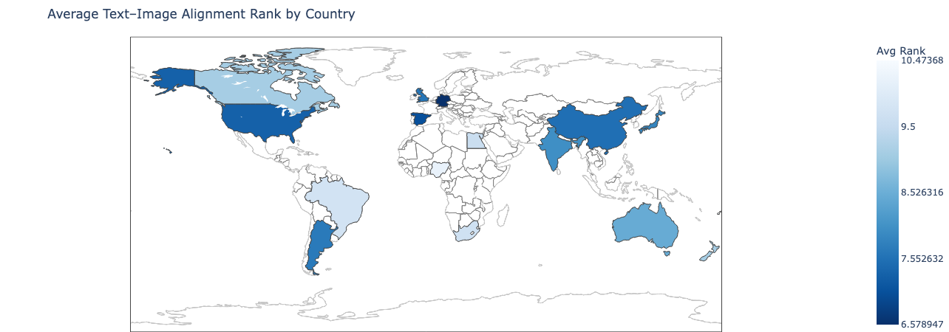
Global alignment map
Notes:
Second, the global alignment map shows which countries tend to align with captions across concepts.

Slide 16
Global alignment map
Overrepresented: Europe, the US (dark blue)
Notes:
On the global alignment map, darker blue countries are overrepresented—meaning their images consistently align more with captions across concepts. These are mainly in Europe and North America.

Slide 17
Global alignment map
Overrepresented: Europe, the US (dark blue)
Underrepresented: Southern Africa, parts of Asia (light)
Notes:
Lighter countries like Nigeria, South Africa, and Egypt are underrepresented, appearing less aligned with text prompts.

Slide 18
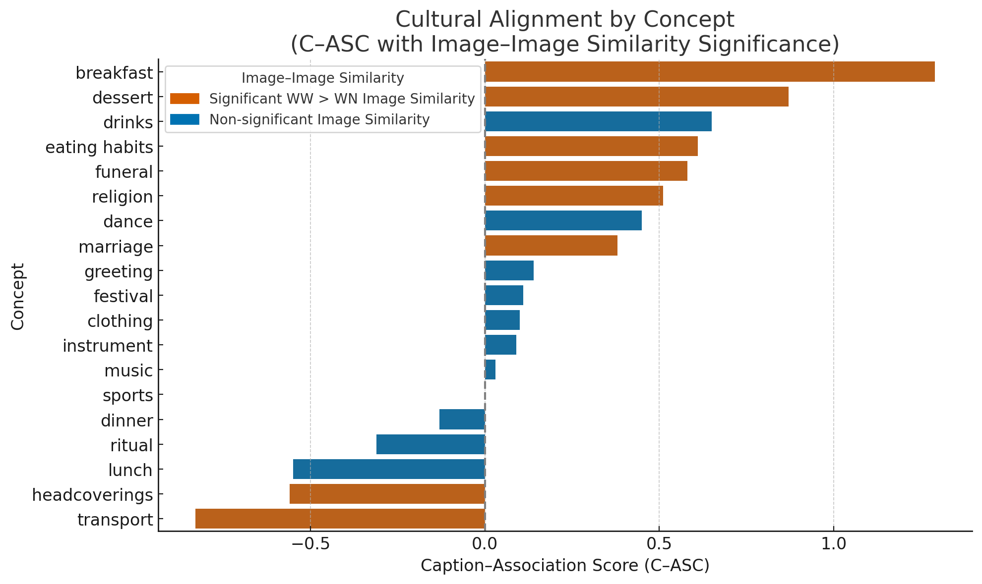
Cross-Modal Analysis
Do Text and Image Biases Agree?
Many concepts show consistent bias across both tasks:
Western-aligned: breakfast, dessert, eating habits
Others show divergence:
Transport: aligned with Non-Western captions, but images cluster Western
Drinks, dance: moderate C–ASC, but no significant image clustering
Some concepts remain neutral: music, festival, ritual
Notes:
To close out the results, we looked at how the two probing tasks relate to one another.
For each concept, we compared the C–ASC score—how strongly a caption aligns with one cultural group—to whether the corresponding images formed tight clusters for Western countries. This gives us a view into how consistent or divergent the model’s biases are across modalities.

Slide 19
Cross-Modal Analysis
Do Text and Image Biases Agree?
Many concepts show consistent bias across both tasks:
Western-aligned: breakfast, dessert, eating habits
Others show divergence:
Transport: aligned with Non-Western captions, but images cluster Western
Drinks, dance: moderate C–ASC, but no significant image clustering
Some concepts remain neutral: music, festival, ritual
Notes:
Some concepts show strong agreement. For example, breakfast, dessert, and eating habits all align strongly with Western images and also form tighter Western clusters in the visual space. These biases are deeply embedded across both image and text.

Slide 20
Cross-Modal Analysis
Do Text and Image Biases Agree?
Many concepts show consistent bias across both tasks:
Western-aligned: breakfast, dessert, eating habits
Others show divergence:
Transport: aligned with Non-Western captions, but images cluster Western
Drinks, dance: moderate C–ASC, but no significant image clustering
Some concepts remain neutral: music, festival, ritual
Notes:
But others are less consistent. Transport, for instance, aligns more with Non-Western images, but still shows significant clustering among Western visuals. Lastly, we see a few neutral concepts like music, festival, and ritual, where the model treats content from different cultures relatively equally.

Slide 21
Key Findings from Probing CLIP’s Cultural Bias
Image–Image Similarity
8 out of 19 concepts show significant Western clustering
Especially strong in funeral, marriage, breakfast, dessert
Text–Image Alignment (C–ASC)
Concepts like breakfast, dessert, eating habits align more with Western images
Some concepts like transport align more with Non-Western images
Cross-Modal Insights
Consistent bias across modalities in everyday and ritual contexts
Divergence in concepts like transport, drinks, dance
Neutral treatment in music, ritual, festival
Visuals: Heatmaps • UMAP • Global Map • C–ASC + Similarity Barplot

Slide 22
Limitations & Future work
Focused only on CLIP due to time and experience constraints
UMAP visualizations reduce interpretability of high-dimensional space
Image preprocessing (center cropping) may discard cultural content
Notes:
This project focused only on CLIP due to time and experience limits. But the two-task probing method can be applied to other models, which future work should explore for broader comparisons.
We also used UMAP for visualization, which simplifies high-dimensional data but can distort some semantic relationships. Combining it with statistical analysis helped, but better interpretability methods could improve this.
Finally, CLIP’s preprocessing might crop out culturally relevant details. Future work should test more adaptive or context-aware image processing to preserve those elements.

Slide 23

Thank you

